Slide 1
Angular Tutorial

Slide 2
Table of contents
Introduction to Angular concepts
Node.js /npm concept
Node.js and npm setup
Modules
Components & Metadata
Data binding
Directives
Pipes
Routing and Navigation
Template Driven Form
Model Driven Form/Reactive Forms
Services
RxJs Basics
Component Interactions
Use of 3rd Party library
References

Slide 3
Introduction to Angular concepts
Angular is a platform and framework for building single-page client applications using HTML and Typescript. Angular is written in TypeScript. It implements core and optional functionality as a set of TypeScript libraries that you import into your apps.
The basic building of angular relies on core features described below:
Modules
Components
Templates
Metadata
Data Binding
Directives
Services
Dependency Injections

Slide 4
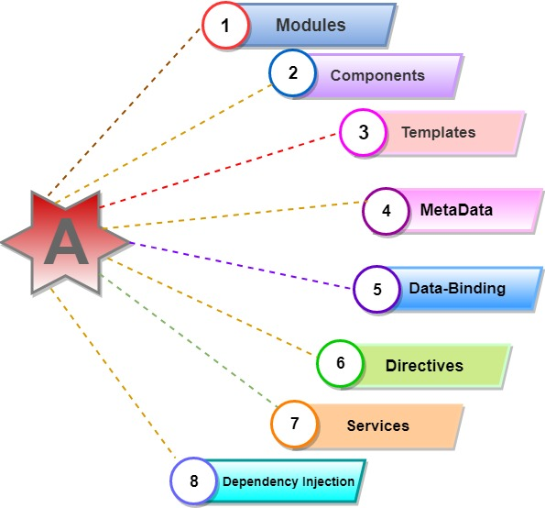
Introduction to Angular concepts

Slide 5
Node.js /npm concept
What is Node.js?
Node.js is an open source server framework, completely free, and used by thousands of developers around the world.
Node.js is an open-source runtime environment for server-side and networking applications and is single-threaded.
It uses the Google JavaScript V8 Engine to execute code.
It is a cross-platform environment and can run on Microsoft Windows Linux, FreeBSD, and IBM
It provides an event-driven architecture and non-blocking I/O that is optimized & scalable.
What is NPM?
NPM is a package manager for Node.js packages, or modules .Here all the node packages are available. By using the NPM, you can install all the packages you want.

Slide 6
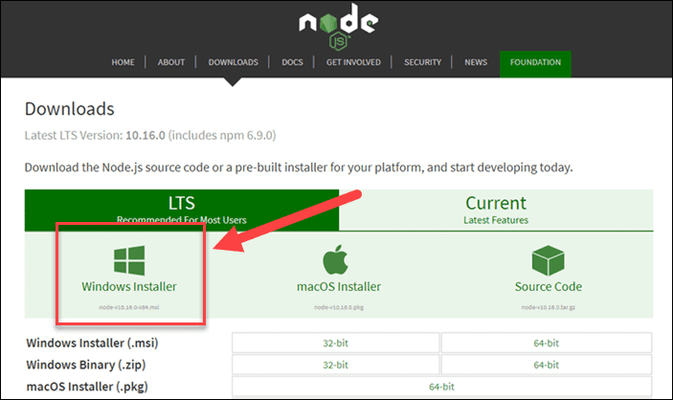
Node.js and npm setup
Step 1: Download Node.js Installer
In a web browser, navigate to https://nodejs.org/en/download/. Click the Windows Installer button to download the latest default version. At the time this article was written, version 10.16.0-x64 was the latest version. The Node.js installer includes the NPM package manager.

Slide 7
Node.js and npm setup
Step 2: Install Node.js and NPM from Browser
Once the installer finishes downloading, launch it. Open the downloads link in your browser and click the file. Or, browse to the location where you have saved the file and double-click it to launch.
The system will ask if you want to run the software – click Run.
You will be welcomed to the Node.js Setup Wizard – click Next.
On the next screen, review the license agreement. Click Next if you agree to the terms and install the software.
The installer will prompt you for the installation location. Leave the default location, unless you have a specific need to install it somewhere else – then click Next.
The wizard will let you select components to include or remove from the installation. Again, unless you have a specific need, accept the defaults by clicking Next.
Finally, click the Install button to run the installer. When it finishes, click Finish.

Slide 8
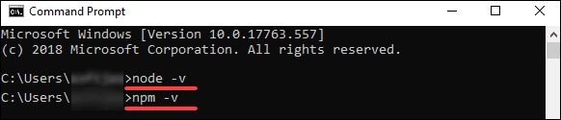
Node.js and npm setup
Step 3: Verify Installation
Open a command prompt (or PowerShell), and enter the following command:
node –v
The system should display the Node.js version installed on your system.
You can do the same for NPM version check after you enter the following command:
npm –v

Slide 9
Angular setup
Install the Angular CLI
You use the Angular CLI to create projects, generate application and library code, and perform a variety of ongoing development tasks such as testing, bundling, and deployment.
To install the Angular CLI, open a terminal window and run the following command:
npm install -g @angular/cli
npm install -g @angular/cli@6.1.1
To create a new workspace and initial starter app
Run the CLI command ng new and provide the name my-app, as shown here:
ng new my-app
The ng new command prompts you for information about features to include in the initial app. Accept the defaults by pressing the Enter or Return key.
The Angular CLI installs the necessary Angular npm packages and other dependencies. This can take a few minutes.
The CLI creates a new workspace and a simple Welcome app, ready to run.

Slide 10
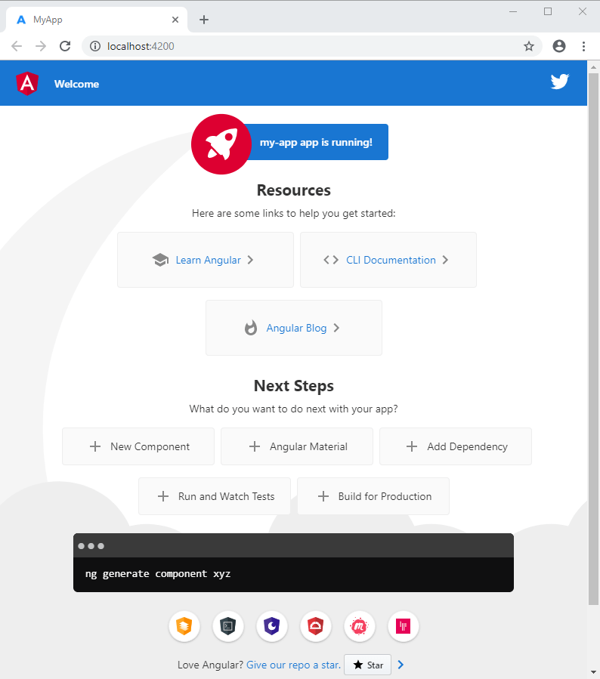
Angular setup
Run the application
The Angular CLI includes a server, so that you can build and serve your app locally.
Navigate to the workspace folder, such as my-app.
Run the following command:
cd my-app
ng serve --open

Slide 11
Modules
Module in Angular refers to a place where you can group the components, directives, pipes, and services, which are related to the application.
In case you are developing a website, the header, footer, left, center and the right section become part of a module.
To define module, we can use the NgModule. When you create a new project using the Angular –cli command, the ngmodule is created in the app.module.ts file by default and it looks as follows −
@NgModule({
declarations: [
AppComponent
],
imports: [
BrowserModule
],
providers: [],
bootstrap: [AppComponent]
})
export class AppModule { }

Slide 12
Components & Metadata
Components are the most basic UI building block of an Angular app. An Angular app contains a tree of Angular components. Angular components are a subset of directives, always associated with a template. Unlike other directives, only one component can be instantiated for a given element in a template.
Metadata and Decorator
Metadata is a way of processing the class and a component called My Component will act as a class until we tell Angular that it's a component. User can use metadata to the class to tell Angular that My Component is a component. Metadata can be attached to TypeScript using a decorator.
A decorator is a function that adds metadata to a class, its members, or its method arguments. A decorator is just a function that gives you access to the target that needs to be decorated.
There are four type of decorators all of them are mentioned below
Types of Decorators:
Class decorators like @Component, @NgModule
Property decorators like @Input and @Output
Method decorators like @HostListener
Parameter decorators like @Injectable
Features of Decorators:
Decorators are predefined in Angular.
Decorators are used by TypeScript compiler.
Decorators are used to attach metadata to a class, objects and method.

Slide 13
Components & Metadata
To create component follow the command:
ng g component Customer
In customer.component.ts file you will see the code below:
import { Component, OnInit } from '@angular/core';
import { CustomerService } from '../shared/services/customer.service';
@Component({
selector: 'app-customer',
templateUrl: './customer.component.html',
styleUrls: ['./customer.component.css'],
providers:[CustomerService]
})
export class CustomerComponent implements OnInit {
constructor() { }
ngOnInit() {
}
}

Slide 14
Components & Metadata
selector:
A CSS selector that tells Angular to create and insert an instance of this component wherever it finds the corresponding tag in template HTML. For example, if an app's HTML contains <app-customer></app-customer>, then Angular inserts an instance of the HeroListComponent view between those tags.
templateUrl:
The module-relative address of this component's HTML template. Alternatively, you can provide the HTML template inline, as the value of the template property. This template defines the component's host view.
styleUrls:
You can load styles from external CSS files by adding a styleUrls property to a component's @Component decorator.
providers:
An array of providers for services that the component requires. In the example, this tells Angular how to provide the CustomerService instance that the component's constructor uses to get the list of heroes to display.

Slide 15
Components & Metadata
Templates and views
You define a component's view with its companion template. A template is a form of HTML that tells Angular how to render the component.
Views are typically arranged hierarchically, allowing you to modify or show and hide entire UI sections or pages as a unit. The template immediately associated with a component defines that component's host view. The component can also define a view hierarchy, which contains embedded views, hosted by other components.

Slide 16
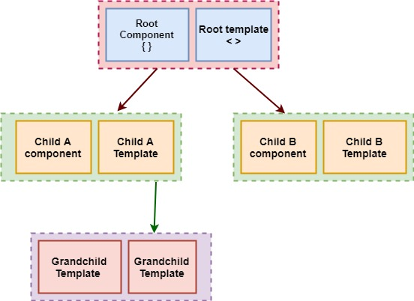
Components & Metadata

Slide 17
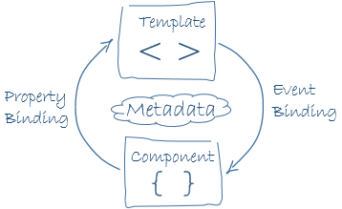
Data binding
Angular allows communication between a component and a DOM. Making it very easy to define interactive application without pulling and pushing the data.
There are two types of data binding.
Event Binding: Our app responds to user input in the target environment by updating our application data.
Property Binding: Itinterpolates values that are computed from application data into the HTML.

Slide 18
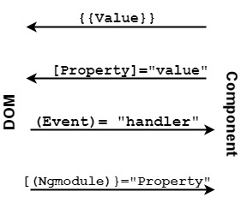
Data binding
<li>{{hero.name}}</li>
<app-hero-detail [hero]="selectedHero"></app-hero-detail>
<li (click)="selectHero(hero)"></li>

Slide 19
Directives
Directives used for expanding the functionality of HTML elements. Three types of directives in Angular are component directives, Structural Directive and Attribute directive.
Component Directives
These form the main class having details of how the component should be processed, instantiated and used at runtime.
Structural Directives
Structural directives are responsible for HTML layout. They shape or reshape the DOM's structure, typically by adding, removing, or manipulating elements.
E.g. *ngIf, *ngFor, and *ngSwitch.
Attribute Directives
An Attribute directive changes the appearance or behavior of a DOM element.
E.g. [ngStyle] , [ngClass]

Slide 20
Directives
Built-in directives
NgClass—adds and removes a set of CSS classes.
NgStyle—adds and removes a set of HTML styles.
NgModel—adds two-way data binding to an HTML form element.
How to Create Custom Directives?
In this section, we will discuss about Custom Directives to be used in components.
Custom directives are created by us and are not standard.
Let us see how to create the custom directive. We will create the directive using the command line. The command to create the directive using the command line is −
ng generate directive highlight
<p appHighlight>Highlight me!</p>

Slide 21
Directives
import { Directive, ElementRef, HostListener } from '@angular/core';
@Directive({
selector: '[appHighlight]'
})
export class HighlightDirective {
constructor(private el: ElementRef) { }
@HostListener('mouseenter') onMouseEnter() {
this.highlight('yellow');
}
@HostListener('mouseleave') onMouseLeave() {
this.highlight(null);
}
private highlight(color: string) {
this.el.nativeElement.style.backgroundColor = color;
}
}

Slide 22
Pipes
Pipes are a useful feature in Angular. They are a simple way to transform values in an Angular template. A pipe takes in a value or values and then returns a value..
The following are commonly used built-in pipes for data formatting:
DatePipe: Formats a date value according to locale rules.
UpperCasePipe: Transforms text to all upper case.
LowerCasePipe: Transforms text to all lower case.
CurrencyPipe: Transforms a number to a currency string, formatted according to locale rules.
DecimalPipe: Transforms a number into a string with a decimal point, formatted according to locale rules.
PercentPipe: Transforms a number to a percentage string, formatted according to locale rules.
Jsonpipe : Converts a value into its JSON-format representation. Useful for debugging.
Slicepipe: Creates a new Array or String containing a subset (slice) of the elements

Slide 23
Pipes
How to Create a Custom Pipe?
To create a custom pipe we will run this command
ng g pipe ConcatNames
in concat-names.pipe.ts file you will see below code:
import { Pipe, PipeTransform } from '@angular/core';
@Pipe({
name: 'concatNames'
})
export class ConcatNamesPipe implements PipeTransform {
transform(value: any, args1?: any, args2?: any): any {
if(value && args1 && args2){
return value[args1]+" - "+value[args2];
}
return null;
}
}
How to use:
{{customer |concatNames:'firstName':'lastName'}}

Slide 24
Routing and Navigation
Routing & Navigation
When a user enters a web application or website, routing is their means of navigating throughout the application. To change from one view to another, the user clicks on the available links on a page.
Angular provides a Router to make it easier to define routes for the web applications and to navigate from one view to another view in the application.
Creating Your First Route
To implement routing in the web application, you'll be making use of the Angular Routing module. Create a file called app.routing.ts inside the src/app folder.
To get started with implementing routing, you need to import the RouterModule and Routes from @angular/router.
import { RouterModule, Routes } from '@angular/router';
You'll also need the ModuleWithProviders module for implementing routing.
import { ModuleWithProviders } from '@angular/core/src/metadata/ng_module';

Slide 25
Routing and Navigation
Create and export a variable called AppRoutes in the app.routing.ts, which would be a collection of all routes inside the Angular application.
export const AppRoutes: Routes = [];
There are two ways to create the routing module: RouterModule.forRoot and RouterModule.forChild.
RouterModule.forRoot is for creating routes for the entire application, and RouterModule.forChild is for creating routes for lazy loaded modules.
In this tutorial, you'll be using RouterModule.forRoot to create routes for the root application.
Create the routing module using RouterModule.forRoot inside the app.routing.ts file.
export const ROUTING: ModuleWithProviders = RouterModule.forRoot(AppRoutes);
Add a route inside the AppRoutes list to show our CalcComponent.
{ path: 'calc', component: CalcComponent }

Slide 26
Routing and Navigation
Here is how the app.routing.ts file looks:
import { RouterModule, Routes } from '@angular/router';
import { ModuleWithProviders } from '@angular/core/src/metadata/ng_module';
import { CalcComponent } from './calc/calc.component‘;
export const AppRoutes: Routes = [
{ path: 'calc', component: CalcComponent }
];
export const ROUTING: ModuleWithProviders = RouterModule.forRoot(AppRoutes);
Here is how the app.module.ts file looks:
import { ROUTING } from './app.routing‘;
@NgModule({
imports: [
BrowserModule,
FormsModule,
ROUTING
],
providers: [],
bootstrap: [AppComponent]
})
export class AppModule { }

Slide 27
Template Driven Form
With a template driven form most of the work is done in the template
and with a model driven form/ reactive form most of the work is done in the component class.
Let us now consider working on the Template driven form.
We will create a simple login form and add the email id, password and submit the button in the form. To start with, we need to import to FormsModule from @angular/core which is done in app.module.ts as follows −
import { FormsModule } from '@angular/forms';
@NgModule({
imports: [
BrowserModule,
FormsModule,
],
providers: [MyserviceService],
bootstrap: [AppComponent]
})
export class AppModule { }

Slide 28
Template Driven Form
So in app.module.ts, we have imported the FormsModule and the same is added in the imports array as shown in the highlighted code.
Let us now create our form in the app.component.html file.
<form #f="ngForm" (ngSubmit)="onSubmitForm()" novalidate>
<div class="form-group">
<label for="username">Username</label>
<input type="text" [(ngModel)]="user.username" name="username" class="form-control" required/>
</div>
<div class="form-group">
<label for="password">Password</label>
<input type="password" [(ngModel)]="user.password" name="password" class="form-control" required/>
</div>
<div class="form-group">
<button type="submit" [disabled]="loading" class="btn btn-primary">Login</button> &nbsp;&nbsp;
<button [disabled]="loading" class="btn btn-primary" (click)="onRegistration()">Registration</button>
</div>
</form>
We have created a simple form with input tags having email id, password and the submit button. We have assigned type, name, and placeholder to it.
In template driven forms, we need to create the model form controls by adding the ngModel directive and the name attribute. Thus, wherever we want Angular to access our data from forms, add ngModel to that tag as shown above. Now, if we have to read the usrername and password, we need to add the ngModel across it.

Slide 29
Template Driven Form
If you see, we have also added the ngForm to the #f. The ngForm directive needs to be added to the form template that we have created. We have also added function onSubmitForm and assigned f.value to it.
Let us now create the function in the login.component.ts and fetch the values entered in the form.
onSubmitForm() {
//console.log(this.user);
this.submitted = true;
this.loading = true;
// stop here if form is invalid
if (this.user['username'] && this.user['password']) {
//this.user['username']="animesh";
//this.user['password']="123456";
this.loginSubs=this.authenticationService.login(this.user['username'],this.user['password'])
.subscribe(
(data) => {
//console.log(data);
if(data){
this.loginFailed=false;
this.router.navigate([this.returnUrl]);
}
else
{
this.loginFailed=true;
this.loading = false;
}
},
(error) => {
this.loginFailed=true;
this.loading = false;
});
}
else{
this.loginFailed=true;
return;
}
}

Slide 30
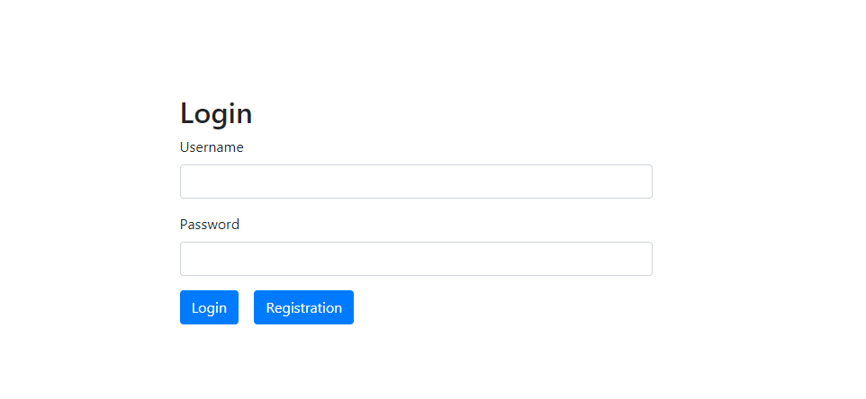
Template Driven Form
In the above login.component.ts file, we have defined the function onSubmitForm. When you click on the form submit button, the control will come to the above function.
This is how the browser is displayed −

Slide 31
Model Driven Form/Reactive Forms
In app.module.ts
import { ReactiveFormsModule } from '@angular/forms';
@NgModule({
imports: [
ReactiveFormsModule,
],
providers: [MyserviceService],
bootstrap: [AppComponent]
})
export class AppModule { }
In login.component.ts, we need to import a few modules for the model driven form. For example, import { FormGroup, FormControl } from '@angular/forms'.
import { Component } from '@angular/core';
import { MyserviceService } from './myservice.service';
import { FormGroup, FormControl } from '@angular/forms';

Slide 32
Model Driven Form/Reactive Forms
loginForm: FormGroup;
this.loginForm = this.formBuilder.group({
username: ['', Validators.required],
password: ['', Validators.required]
});
onSubmit() {
this.submitted = true;
// stop here if form is invalid
if (this.loginForm.invalid) {
this.loginFailed=true;
return;
}
this.loading = true;
}

Slide 33
Model Driven Form/Reactive Forms
The variable formdata is initialized at the start of the class and the same is initialized with FormGroup as shown above. The variables emailid and passwd are initialized with default values to be displayed in the form. You can keep it blank in case you want to.
This is how the values will be seen in the form UI.
We have used formdata to initialize the form values; we need to use the same in the form UI login.component.html.
<form [formGroup]="loginForm" (ngSubmit)="onSubmit()">
<div class="form-group">
<label for="username">Username</label>
<input type="text" formControlName="username" class="form-control" [ngClass]="{ 'is-invalid': submitted && formDetails.username.errors }" />
<div *ngIf="submitted && formDetails.username.errors" class="invalid-feedback">
<div *ngIf="formDetails.username.errors.required">Username is required</div>
</div>
</div>
<div class="form-group">
<label for="password">Password</label>
<input type="password" formControlName="password" class="form-control" [ngClass]="{ 'is-invalid': submitted && formDetails.password.errors }" />
<div *ngIf="submitted && formDetails.password.errors" class="invalid-feedback">
<div *ngIf="formDetails.password.errors.required">Password is required</div>
</div>
</div>
<div class="form-group">
<button type="submit" [disabled]="loading" class="btn btn-primary">Login</button> &nbsp;&nbsp;
<button [disabled]="loading" class="btn btn-primary" (click)="onRegistration()">Registration</button>
</div>
</form>

Slide 34
Model Driven Form/Reactive Forms
For the submit button, we have added disabled in the square bracket, which is given value - !formdata.valid. Thus, if the formdata.valid is not valid, the button will remain disabled and the user will not be able to submit it.
Let us see the how this works in the browser −

Slide 35
Differences b/w Template-driven and Reactive Forms
Below are some of the high-level differences between the two types:
Template-driven forms make use of the "FormsModule", while reactive forms are based on "ReactiveFormsModule".
Template-driven forms are asynchronous in nature, whereas Reactive forms are mostly synchronous.
In a template-driven approach, most of the logic is driven from the template, whereas in reactive-driven approach, the logic resides mainly in the component or typescript code. Let us get started by generating a component and then we'll update our form code.
Conclusion
We have seen both the ways to build forms in Angular. The template-driven approach would be familiar to those coming from Angular.Js 1.x background and thus makes it easy for migrating their app to the latest Angular version. The Reactive approach removes the core validation logic from the template and hence makes the template code quite clean. From a unit testing perspective, it is easier to write unit tests with Reactive forms, since the logic is contained inside our component. And for dynamic form creation we prefer Reactive form rather than template driven form.

Slide 36
Services
Service is a broad category encompassing any value, function, or feature that an app needs. A service is typically a class with a narrow, well-defined purpose. It should do something specific and do it well. A component can delegate certain tasks to services, such as fetching data from the server, validating user input, or logging directly to the console. By defining such processing tasks in an injectable service class, you make those tasks available to any component. With services, we can access methods and properties across other components in the entire project.
To create a service we can use the command below:
ng g service Customer
In customer.service.ts file you will see the code below
import { Injectable } from '@angular/core';
@Injectable()
export class CustomerService {
constructor() { }
}

Slide 37
Http Service
Http Service will help us fetch external data, post to it, etc. We need to import the http client module to make use of the http service.
Let us consider an example to understand how to make use of the http service.
To start using the http service, we need to import the module in app.module.ts as shown below −
import { HttpClientModule } from '@angular/common/http';
@NgModule({
imports: [
HttpClientModule
],
providers: [],
bootstrap: [AppComponent]
})
export class AppModule { }

Slide 38
Http Service
import { Injectable } from '@angular/core';
import { HttpClient, HttpHeaders } from '@angular/common/http';
@Injectable()
export class CustomerService {
private REST_API_SERVER = "http://localhost:4200";
private headers = new HttpHeaders({'Content-Type':'application/json; charset=utf-8'});
constructor(private httpClient: HttpClient) { }
public getAllCustomers(){
return this.httpClient.get(this.REST_API_SERVER,{ headers: this.headers});
}
}

Slide 39
Dependency Injection
Dependency injection (DI), is an important application design pattern. Angular has its own DI framework, which is typically used in the design of Angular applications to increase their efficiency and modularity.
Dependencies are services or objects that a class needs to perform its function. DI is a coding pattern in which a class asks for dependencies from external sources rather than creating them itself.
import { Injectable } from '@angular/core';
import { HEROES } from './mock-heroes';
@Injectable({
// we declare that this service should be created
// by the root application injector.
providedIn: 'root',
})
export class HeroService {
getHeroes() { return HEROES; }
}

Slide 40
Dependency Injections
import { Component } from '@angular/core';
import { Hero } from './hero';
import { HeroService } from './hero.service';
@Component({
selector: 'app-hero-list',
template: `
<div *ngFor="let hero of heroes">
{{hero.id}} - {{hero.name}}
</div>
`
})
export class HeroListComponent {
heroes: Hero[];
constructor(heroService: HeroService) {
this.heroes = heroService.getHeroes();
}
}

Slide 41
RxJs Basics
RxJS is a library for reactive programming using Observables, to make it easier to compose asynchronous or callback-based code
Features of RxJS -In RxJS, the following concepts takes care of handling the async task −
Observable
An observable is a function that creates an observer and attaches it to the source where values are expected, for example, clicks, mouse events from a dom element or an Http request, etc.
Observer
It is an object with next(), error() and complete() methods, that will get called when there is interaction to the with the observable i.e. the source interacts for an example button click, Http request, etc.
Subscription
When the observable is created, to execute the observable we need to subscribe to it. It can also be used to cancel the execution.

Slide 42
RxJs Basics
Operators
An operator is a pure function that takes in observable as input and the output is also an observable.
Subject
A subject is an observable that can multicast i.e. talk to many observers. Consider a button with an event listener, the function attached to the event using addlistener is called every time the user clicks on the button similar functionality goes for subject too.
var obs = Rx.Observable.interval(500).take(5)
.do(i => console.log("obs value "+ i) );
obs.subscribe(value => console.log("observer 1 received " + value));
obs.subscribe(value => console.log("observer 2 received " + value));
Output of the logic
obs value 0
observer 1 received 0
obs value 0
observer 2 received 0
obs value 1
observer 1 received 1
obs value 1
observer 2 received 1

Slide 43
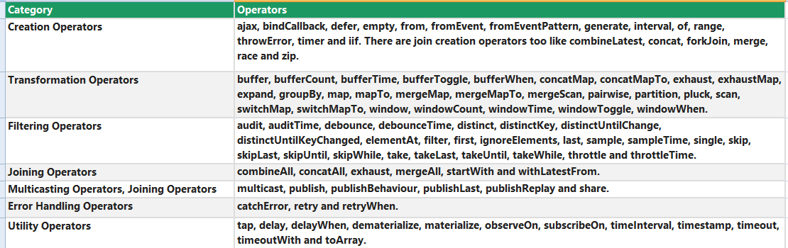
RxJs Operators

Slide 44
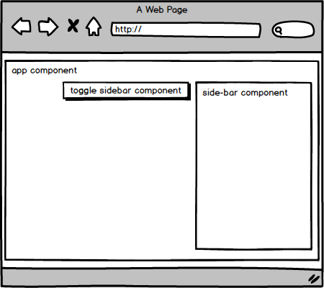
Component Interactions
3 ways to communicate between Angular components
Passing the reference of one component to another -- @ViewChild/ @ViewChildren
Communication through parent or child component -- @Input /@Output
Communication through Service -- Subject /BehaviorSubject

Slide 45
Use of 3rd Party library
The most popular 3rd party libraries are :
https://www.npmjs.com/
RxJs
Bootsrap
Jquery
Under Score
Lodash
primeNg
Fontawesome
AgGrid
High Charts
D3 js
CK Editor

Slide 46
References
https://nodejs.org/en/download/
https://angular.io/
https://www.npmjs.com/
https://www.tutorialspoint.com/angular4/index.htm
https://www.pluralsight.com/guides/difference-between-template-driven-and-reactive-forms-angular
https://www.tutorialandexample.com/angular-8-architecture/
https://www.primefaces.org/primeng/v6.1.7/#/
https://getbootstrap.com/docs/4.5/getting-started/introduction/
https://fontawesome.com/v4.7.0/
https://www.ag-grid.com/
https://underscorejs.org/

Slide 47
Thank you

